Slide 1

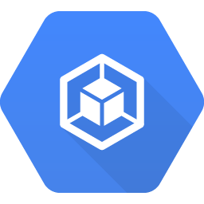
network-1
network-2
Subnet-a (us-east1)
10.0.0.0/8
Subnet-b (asia-east1)
172.16.0.0/24
Peer-12
Container Engine
Container Engine
Peer-21

